Slide 1
2 Cents For US Job Seekers
by Project Group C
Dan
Shweta
Addison
Santiago

Slide 2
Why look in to this? With technology politics and cultural changes happening so fast visualizing where the job markets are going can help you focus your job search, find jobs more resilient to change and increase your chances of being hired. It can help you define and explore different careers and training programs to ensure your success in the professional environment and long term employment.

Slide 3
We Ask Ourselves: Which job groups have had an increase in employment numbers and which have decreased? Which particular jobs have seen faster rise, and which jobs are declining at fast pace? What would things look like in a few more years and perhaps know why?

Slide 4
How Did It Go? In general, we found answers to our questions based on household survey conducted by Bureau of Labour Statistics.(U.S. Department of labor) * Some limitations to our data set: illegal workers, job popularity. * Our data is influenced by population growth.

Slide 5
Data: - Acquired API for Bureau of Labour Statistics - Data was found in xlsx form, containing info on major job groups, detailed jobs, sorted by year(2013-2017), employment total(# dis. In thousands). - From this dataset, we were able to display job trends and change over the years for groups and specific years. -Data is not biased; includes agriculture, self employed (unincorporated), unpaid family workers and private household workers among the employed.

Slide 6
Data Clean-up and Exploration
First Attempt: Using Json to get annual total employment amount by industry from 2008-2017
Second Attempt: Annual total employment amount by Occupation from 2013-2017
Understand data – Create the DataFrame – Massage Data
Jupyter Notebook Demo

Slide 7
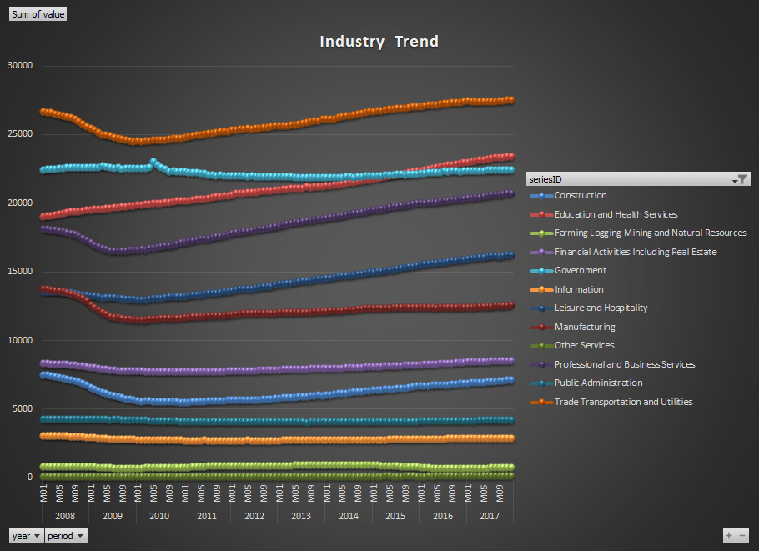

Slide 8
Data Analysis and Discussion

Slide 9
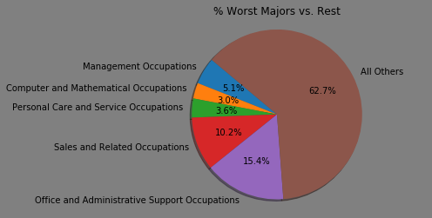
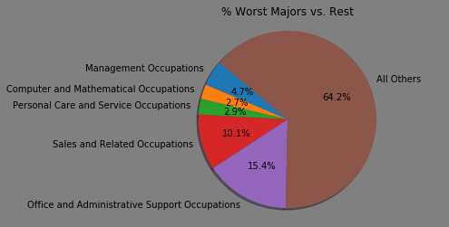
Worst Major US
Job Groups in Decline
2013
2017

Slide 10
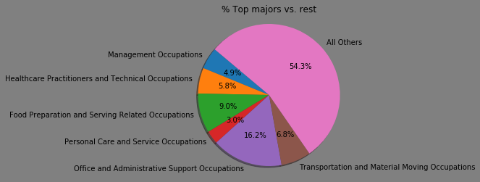
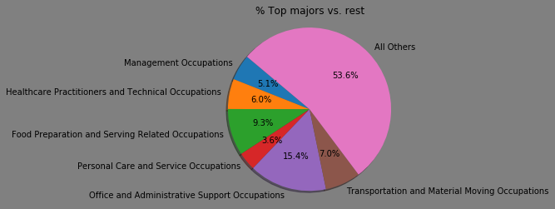
Top Major US
Job Groups on the Rise
2013
2017

Slide 11
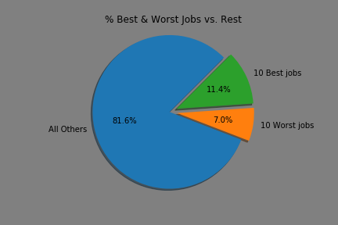
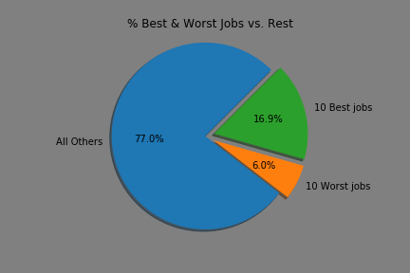
Best vs. Worst US
Jobs Grouped
2013
2017

Slide 12
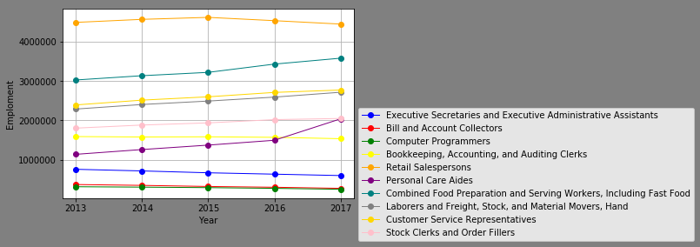
Top 5
Best & Worst Jobs
Five Year Trend in the US

Slide 13
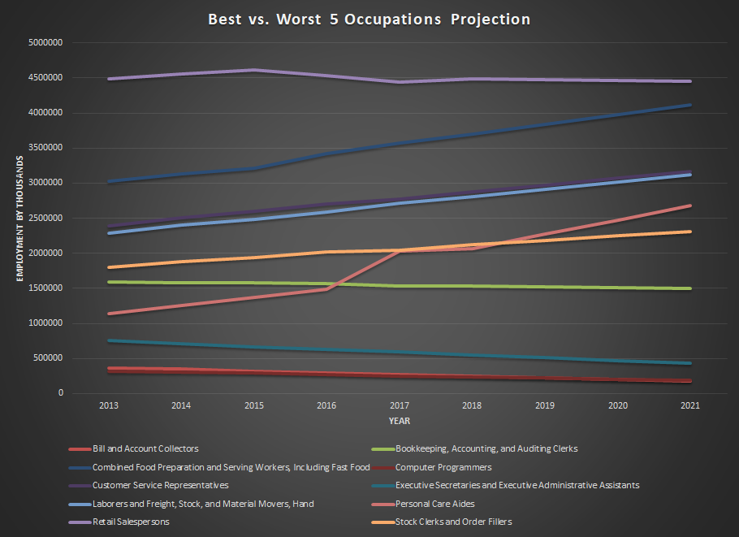

Slide 14
Post Mortem: - We were trying to figure out the reasons why there is decline in specific jobs, and vice versa. And we attempted it with one example. - If we look at the bar chart, it shows a very little to no change in the total number of employment within each job sector. - There is huge increase in the healthcare sector, but there is a dip in Financial industry. - According to our projection and data extracted from different industries, there is a high chance to see a crash in financial industry as all the jobs are being taken over by the automation. For example: bank tellers are being replaced by Automated Teller Machines.

Slide 15
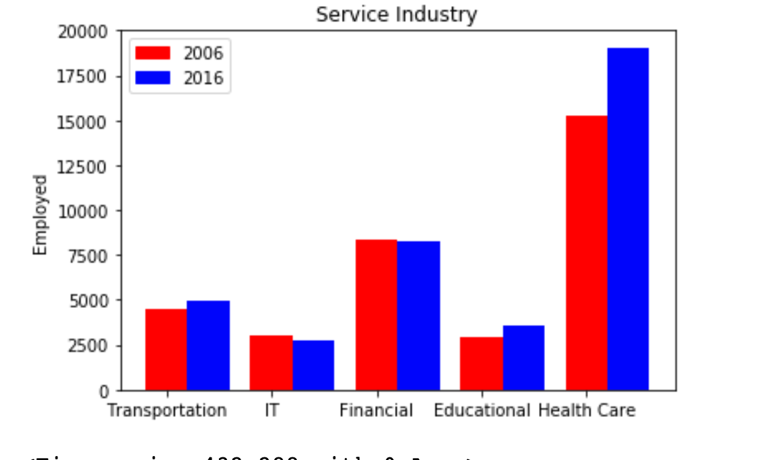
JOBS TRENDS IN SERVICE INDUSTRY IN LAST 10 YEARS(U.S.A)
Jobs are in Thousands

Slide 16
Questions ?

